Slide 1


Amal Bank Somalia
Digital Marketing & Branding Strategy.
Software Class Assignment
Group

Slide 2

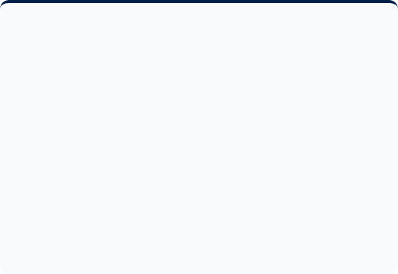
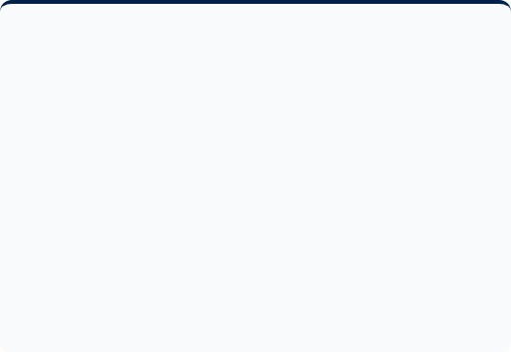
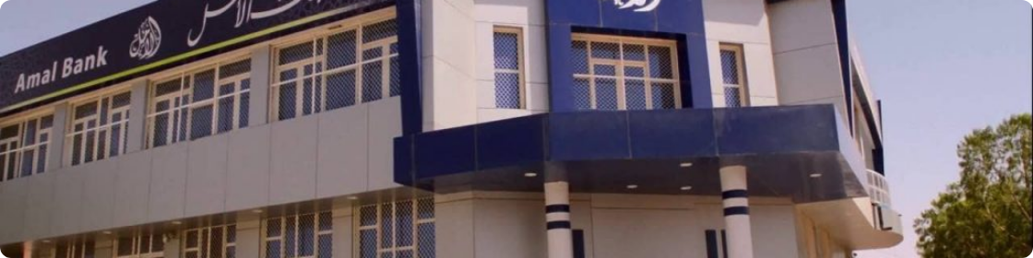

AMAL BANK OVERVIEW
Market Positioning
Global Connectivity
Amal Bank stands as one of the largest financial institutions in Somalia, serving as a pillar for modern banking services.
A leader in the Somali International Payment sector, facilitating seamless transactions across borders.
Mission-driven approach focused on providing secure, ethical, and accessible financial services to the public.
It specializes in Sharia-compliant financial solutions, catering to both local and international Somali communities.

Slide 3


SOCIAL MEDIA PRESENCE
Facebook Strategy
Primary Channel: Facebook serves as the central hub for customer engagement.
High Frequency: Active posting schedule with approximately 2 posts per day.
Content Mix: Strategic use of high-quality posters, images, and marketing videos.
Visual Dominance: Static posters and images are the most common content types utilized.

Slide 4



BRANDING ANALYSIS
Visual Identity
Amal Bank maintains a high level of brand consistency across all digital touchpoints.
Slogan: "Your Future. Our Mission"
Color Palette: Professional Navy Blue and White.
Logo Quality: Clear, modern, and highly recognizable.

Slide 5
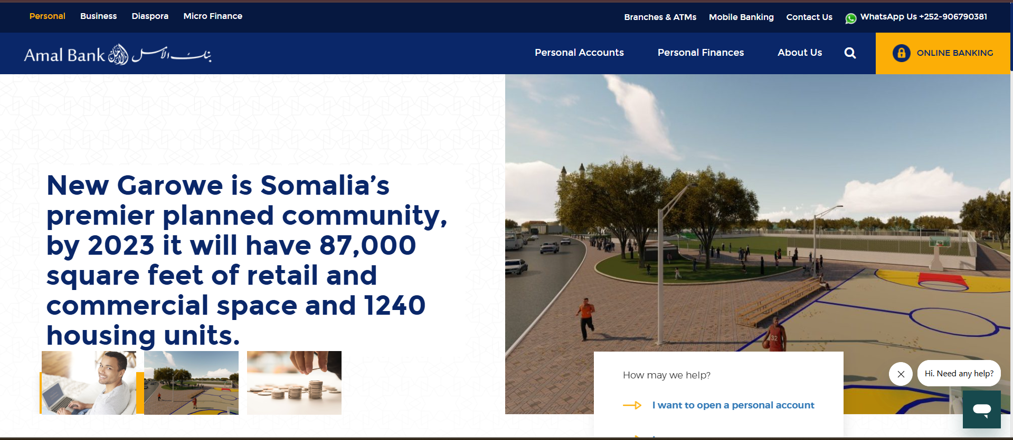
WEBSITE
Brand Consistency
Amal Bank maintains a unified visual identity across all social media platforms and digital touchpoints.
Website UI/UX: Modern, well-designed, and exceptionally user-friendly.
Regular Updates: The digital platform is maintained and updated frequently to ensure reliability.

Slide 6
STRENGTHS & WEAKNESSES
Audit Category | Detail / Evaluation | Status
Branding | Highly consistent visual identity and clear professional logo across all channels.
Web Presence | Excellent website design with high usability and regular content updates.
Platform Reach | Limited platform diversity; lack of presence on TikTok and Instagram.
Content Type | Over-reliance on static posters rather than interactive or short-form video content.

Slide 7
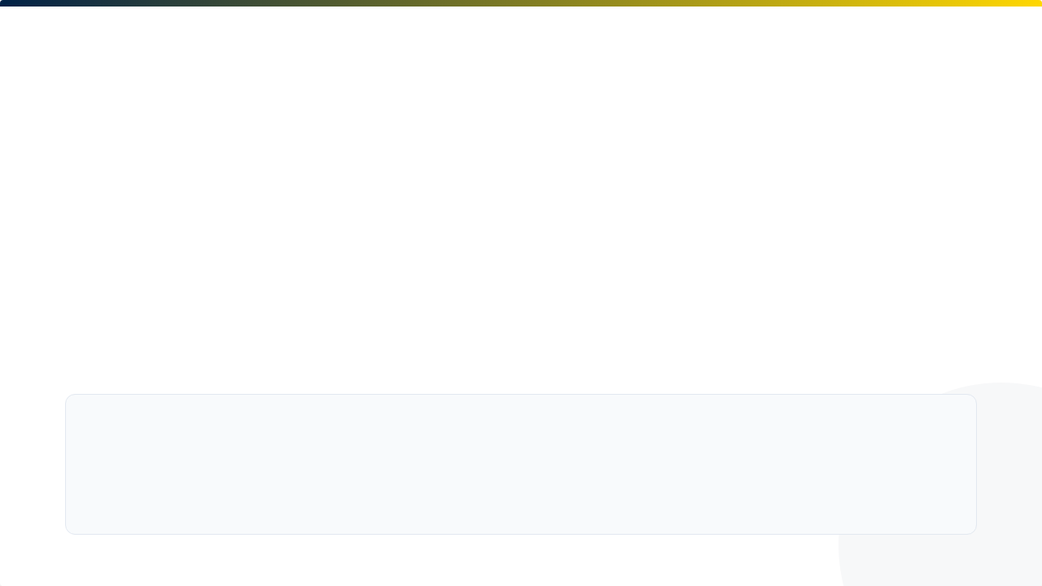







STRATEGIC RECOMMENDATIONS
Platform Expansion
Video-First Content
Digital Support
Launch official profiles on TikTok and Instagram to engage younger demographics and increase reach.
Pivot toward short-form video content (Reels/TikToks) to explain services and increase engagement.
Enhance customer support on social media to provide real-time responses to customer inquiries.
Interactive Marketing
Introduce live Q&A sessions and interactive polls to explain complex banking products to the public.

